Slide 1




Lifting Water, Falling Water:
Energy Balance of the Colorado River
Jesse Clah and Karl Flessa
Geosciences, University of Arizona
Space Grant Symposium
Sheraton Phoenix Airport Hotel Tempe
1600 South 52nd Street
Tempe, AZ 85281
Friday, April 22, 2017

Slide 2
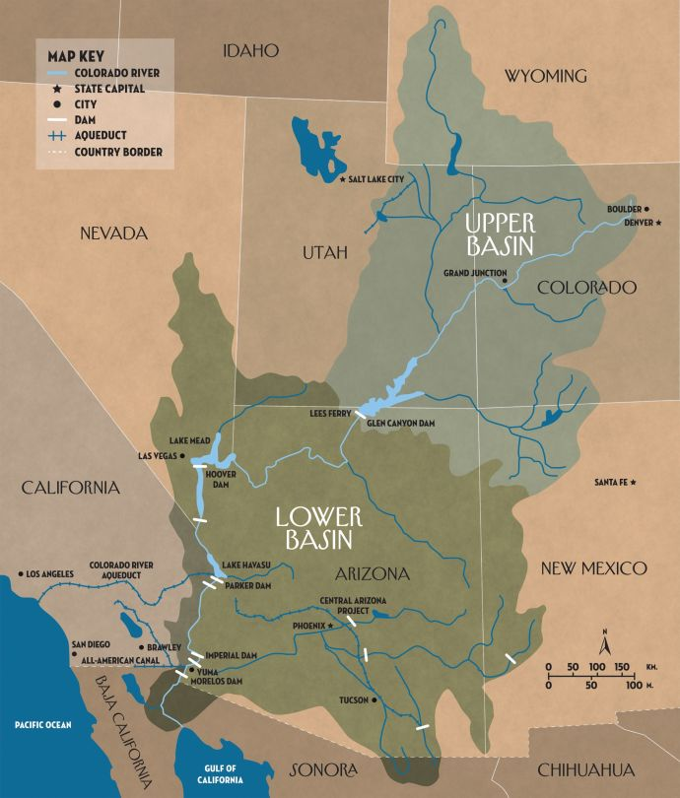


Can a river system have a carbon footprint?
How is water diverted?
How is it transported?
Where does it go?
How much energy is needed to transport water?
Colorado River Basin
Source: New Yorker

Slide 3


Methods
Identify reservoirs along the river and its tributaries.
Determined which reservoirs produced energy via hydro-electric plant.
Collect data on energy output of power plants for a 10 year average.
Identify agencies that distribute water, how they do it and what power source they use.
Calculate energy produced and consumed in terms of CO₂ output (ton).

Slide 4
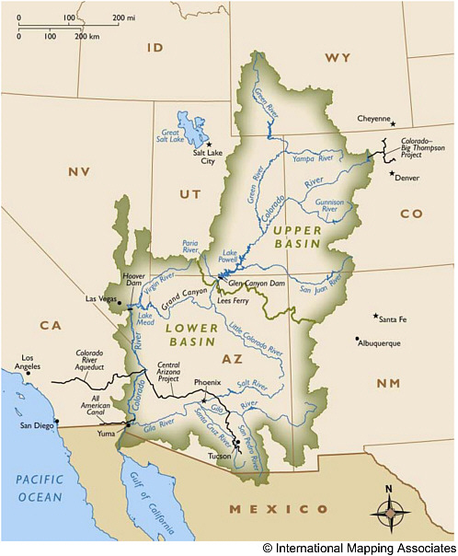
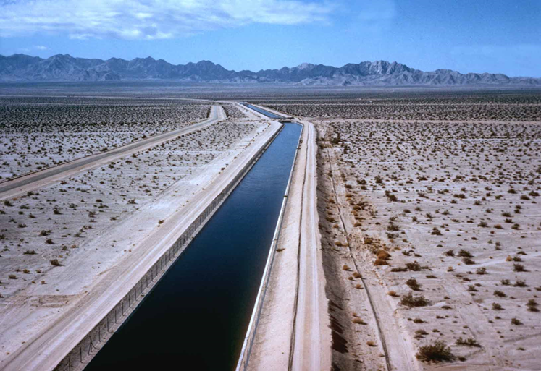
How is Colorado River Water diverted?
Aqueducts within the basin
Aqueducts for out-of-basin transfers
Colorado River Basin. Water Projects are shown in black.
Source: www.nap.edu
Colorado River Aqueduct
Source: www.mwdh2o.com/DocSvcsPubs/inspection-trip

Slide 5
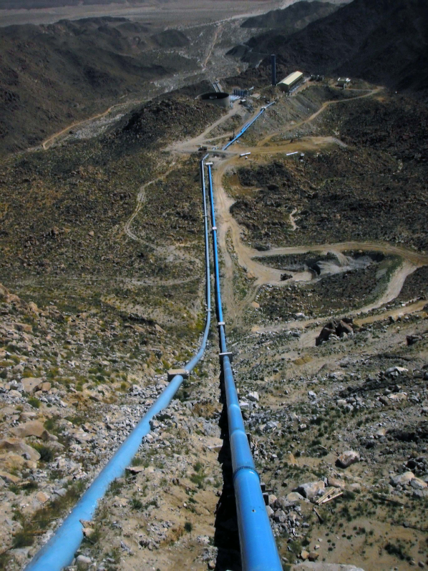
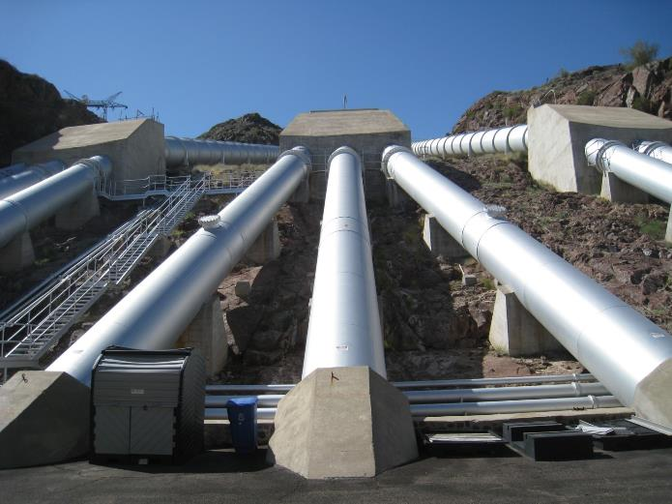
How is it Transported?
Pumping stations
Natural gravity fall
Pipes
Canal to reservoir to pumping plant
Tijuana Aqueduct supply pipes
Source: www.secner.com
Whitsett Pumping Plant at Lake Havasu
Source : Bureau of Reclamation

Slide 6
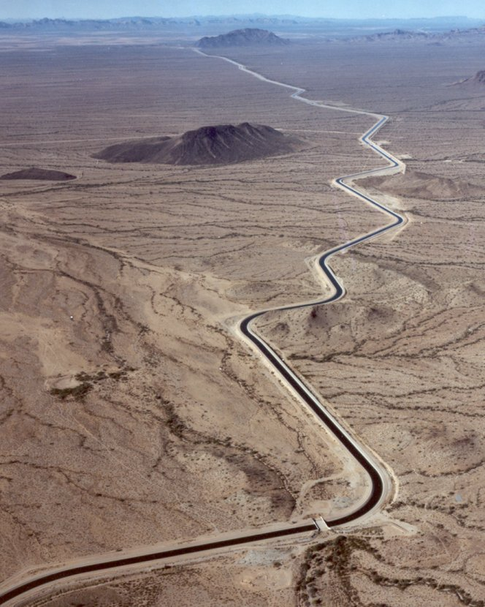
Where does it go?
All over the Southwestern States
  Arizona
  California
  Colorado
  Nevada
  New Mexico
  Utah
  Wyoming
Mexico
  Mexicali
  Tijuana
Central Arizona Project runs 540 km through Arizona
Source: Bureau of Reclamation

Slide 7
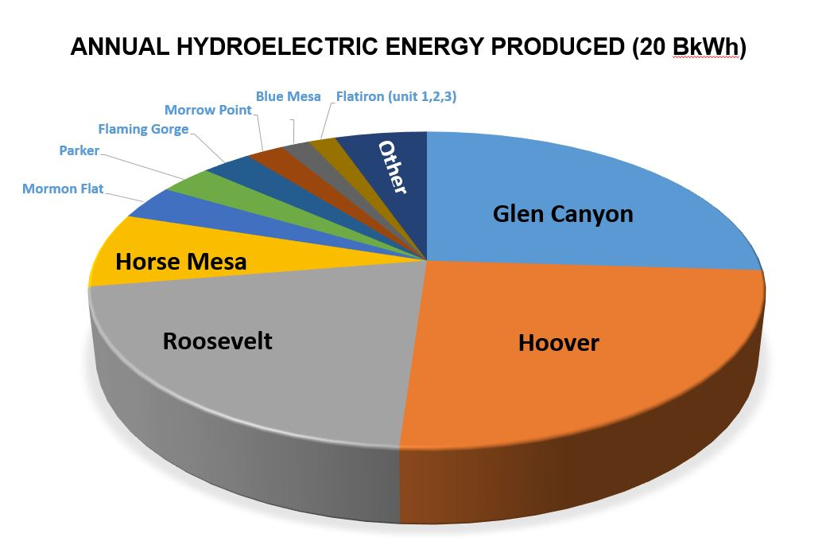
What Powers the Transport?

Slide 8
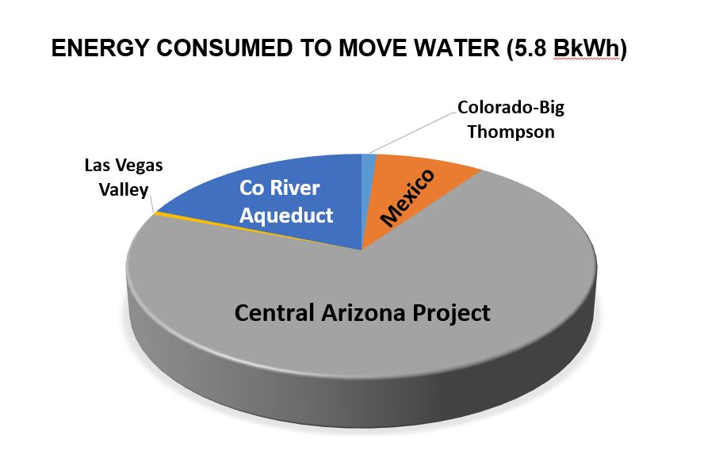


What Powers the Transport?

Slide 9
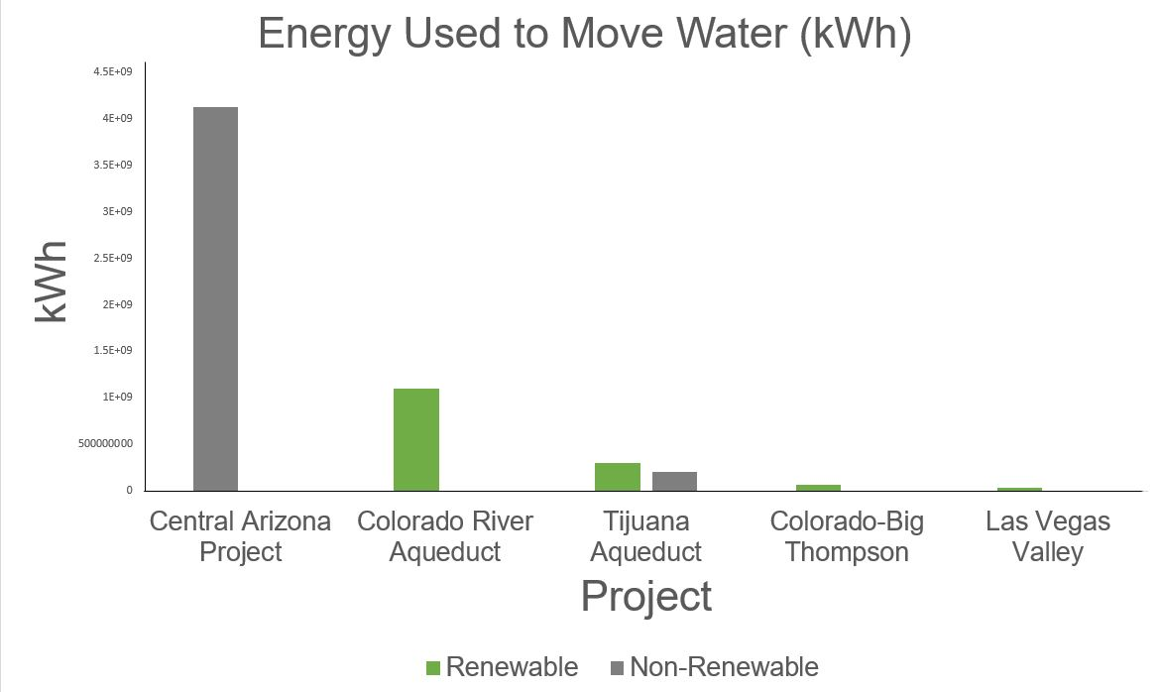
Results

Slide 10
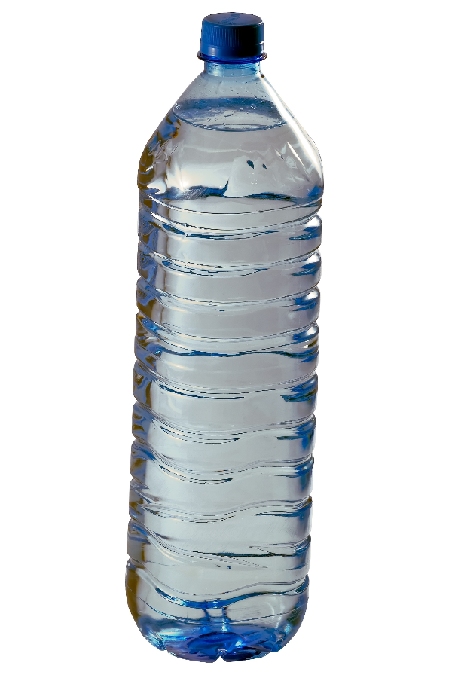

Conclusions
Only 5 projects use energy to move water
4 of the 5 use or reclaim energy via hydroelectric
Tijuana Aqueduct uses a mix of energy: geothermal and natural gas
The CAP uses all coal fired energy resulting in a carbon foot print of 4.7 tons per acre feet or 0.38 grams per liter.
Most Colorado River water is “green”
Source: www.watermart.com

Slide 11
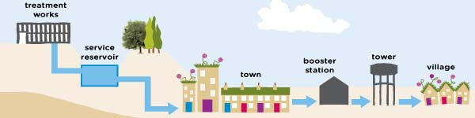

Future Directions
Collecting data on evaporation rates on open canals
Data on energy used to treat, store and then deliver water to cities and homes.
Can this research be applied to other river systems

Slide 12


Thank you

